Slide 1
Car Parking spaces in Dublin City Centre
Ailis Curran

Slide 2
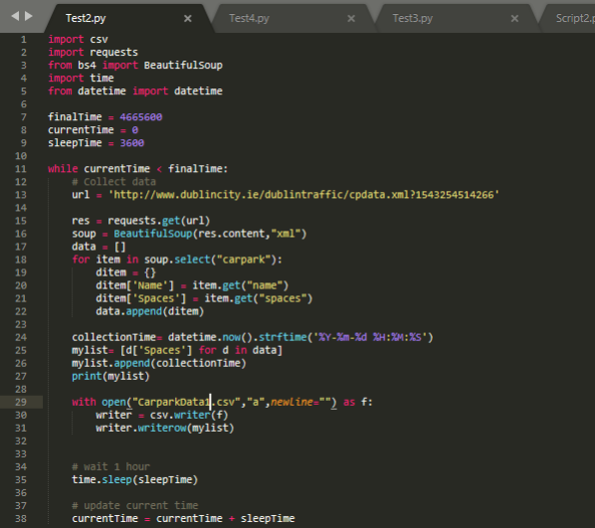
Python
Started with scraping the Dublin City Centre website using Python.

Slide 3

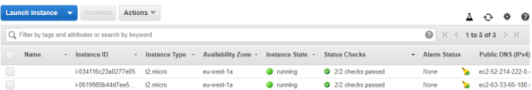
R Studio & AWS
Sample of the data set on R Studio
Running EC2 instance on Amazon Web Services

Slide 4
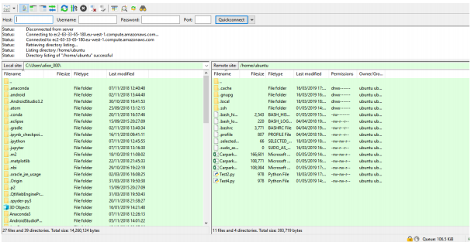
FileZilla
Filezilla- Showing access to the instance on AWS

Slide 5

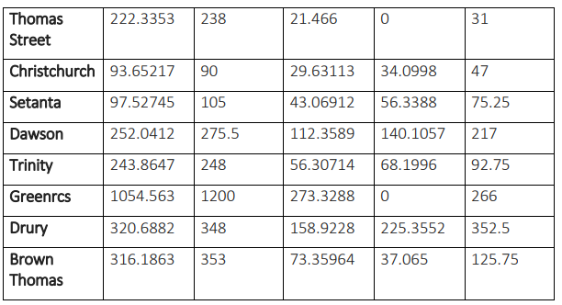
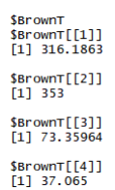
Data Quality Report
Data Quality Report- R Studio Code
Table of Data Quality Report Results
Code Output

Slide 6
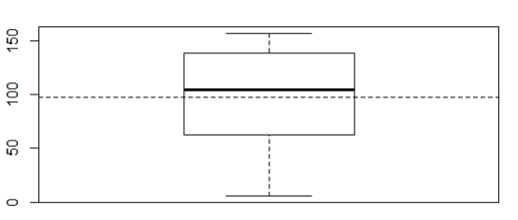
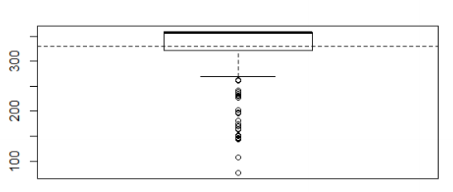
Comparisons of Boxplots
Boxplot of Setanta car park
Boxplot of Arnotts car park

Slide 7
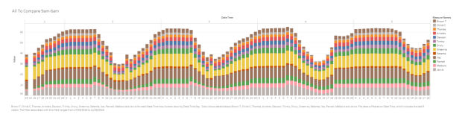
Tableau- Comparing Different Car Parking Spaces at different times.

Slide 8
Findings from the Project
Less Car Parking spaces on the North-Side.
Car Parks busiest from 8am-6pm Monday to Friday.
Car Parks busiest from 10am- 4pm Saturday to Sunday.
Car Parks that are not attached to shops are less busier.
Arnotts Car Park was overall the busiest.
Setanta Car Park was overall the quietest.

Slide 9
Future of the Project
Car Parking App.
Useful to Dublin City Council for future builds/renovation.
Useful for Department of Transport & Department of Environment to analyse the trends and to de-increase cars in and out of the city.

Slide 10
Questions?
Ailis Curran

